Slide 1
Retail Trends to Watch for 2023
December 2022
Sky Canaves
Suzy Davidkhanian
Senior Analyst
Principal Analyst
Blake Droesch
Andrew Lipsman
Senior Analyst
Principal Analyst

Slide 2
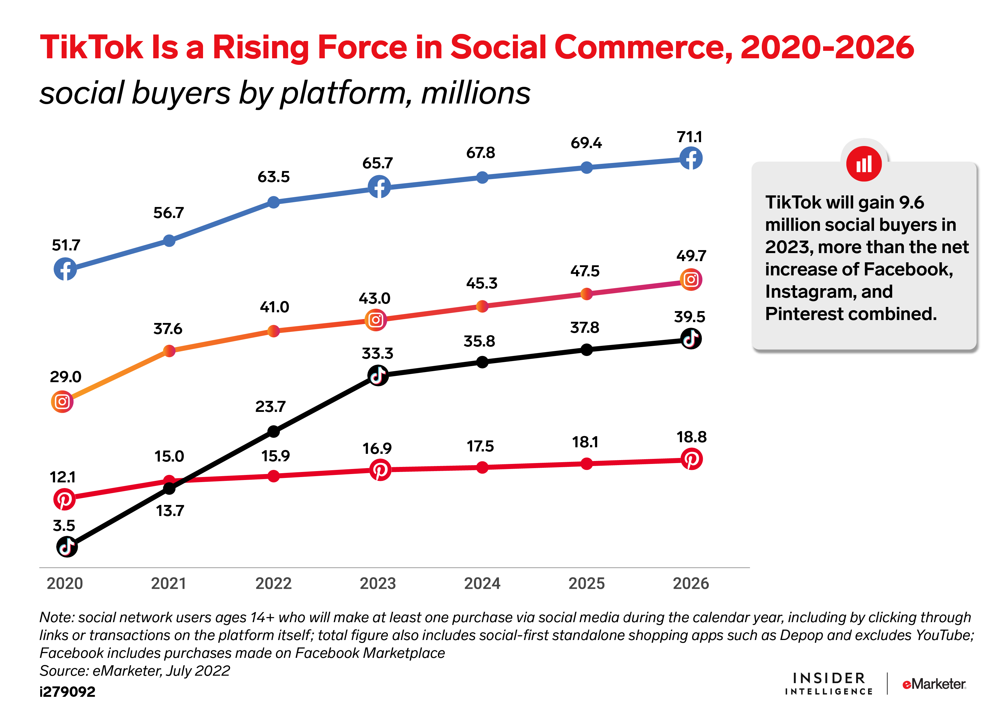
Gen Z’s Social Commerce Habits Are Shaped by Chinese Players
TikTok’s strong Gen Z appeal will fuel adoption of new shopping habits.
TikTok gains ground as a platform for product discovery and search—#TikTokMadeMeBuyIt has nearly 32 billion video views to date.
The US launch of TikTok Shop will bring livestreaming and algorithm-driven commerce to the viral video platform.
Chinese players like Shein, Pinduoduo, and AliExpress make inroads with trend-seeking and budget conscious US shoppers.
Notes:
Closed Loop measurement + First Party Targeting allays growing privacy concerns
Prices continue to rise as increased Ecommerce ad demand has grown (more retailers, brands)
Retail Media Ads are typically sold via auction & increase demand has triggered organic growth
Advertisers have reported lower ROI
Increase in Retail Ecommerce Sales Overall

Slide 3
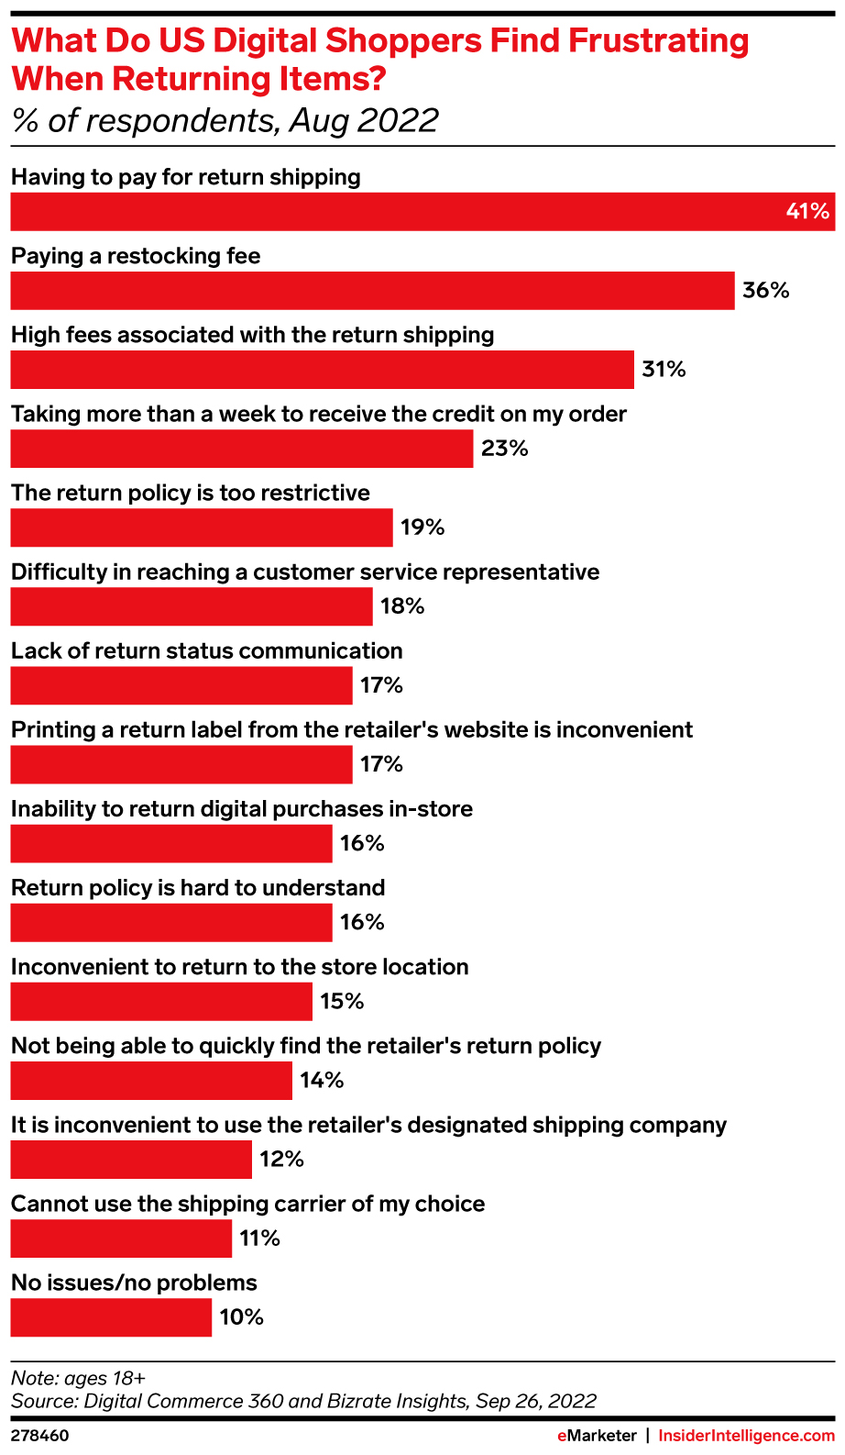
Return Policies Make or Break Retail Loyalty
The reverse last mile will be a focal point in reducing friction around returns.
Walmart, Target, and Overstock are expanding return options to include at-home pickup and click-and-collect return options.
At the same time, many retailers have ended free return policies.
Will this be a new opportunity for delivery companies like DoorDash, Uber, and Instacart?
Notes:
Closed Loop measurement + First Party Targeting allays growing privacy concerns
Prices continue to rise as increased Ecommerce ad demand has grown (more retailers, brands)
Retail Media Ads are typically sold via auction & increase demand has triggered organic growth
Advertisers have reported lower ROI
Increase in Retail Ecommerce Sales Overall

Slide 4
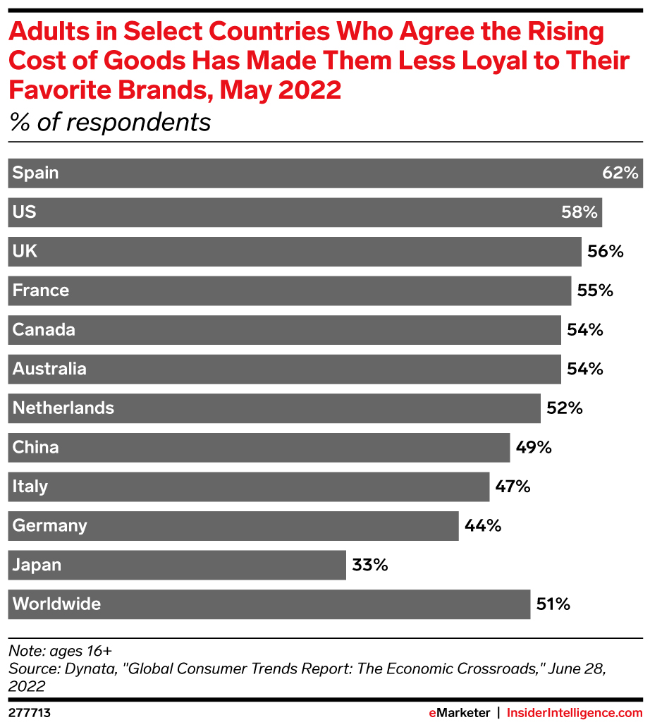
A Tale of Two Consumers: Mid-Tier Brands Face Uphill Battle
Brands and retailers that try to be everything to everyone will suffer as loyalty wanes.
Mid-tier brands Macy’s and Kohl’s reported soft sales
Meanwhile, discount and dollar stores are seeing increases in foot traffic and growing their fleet
On the other hand, wealthy consumers are fueling a boom in the luxury market. Neiman Marcus Group reporting that 70% of its stores had their highest revenue in 10 years
Notes:
Closed Loop measurement + First Party Targeting allays growing privacy concerns
Prices continue to rise as increased Ecommerce ad demand has grown (more retailers, brands)
Retail Media Ads are typically sold via auction & increase demand has triggered organic growth
Advertisers have reported lower ROI
Increase in Retail Ecommerce Sales Overall

Slide 5
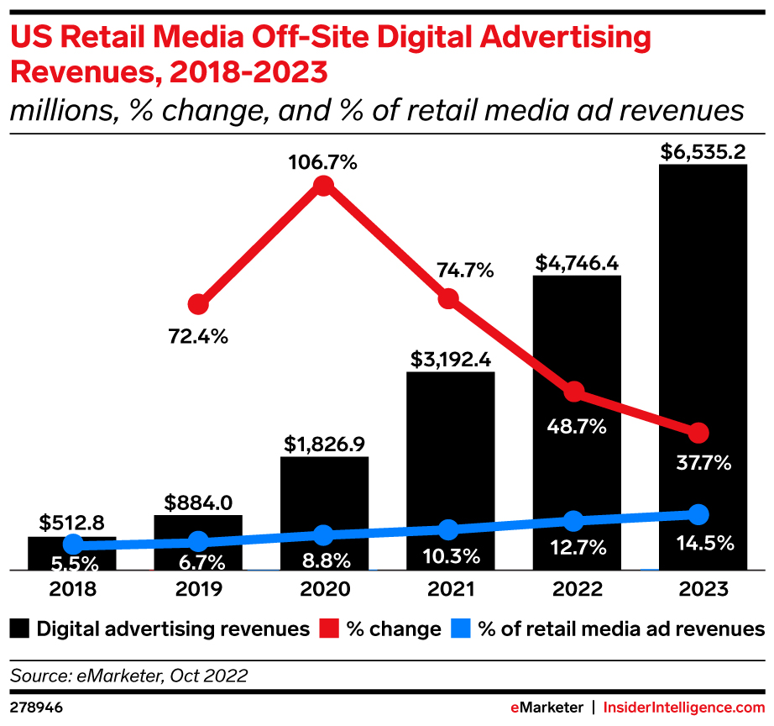
Retail Media Is Ready to Disrupt the $70 Billion Linear TV Ad Market
Retail media moves aggressively into streaming TV; off-site retail media ad spend growth will more than double on-site.
Amazon Thursday Night Football advances down the field. Prime Video will host the first Black Friday NFL game in 2023.
Walmart’s partnerships with The Trade Desk and Paramount+ promise data-powered CTV inventory.
Kroger’s Roku partnership proves the power of closed-loop attribution for TV ads.
Notes:
Closed Loop measurement + First Party Targeting allays growing privacy concerns
Prices continue to rise as increased Ecommerce ad demand has grown (more retailers, brands)
Retail Media Ads are typically sold via auction & increase demand has triggered organic growth
Advertisers have reported lower ROI
Increase in Retail Ecommerce Sales Overall

Slide 6
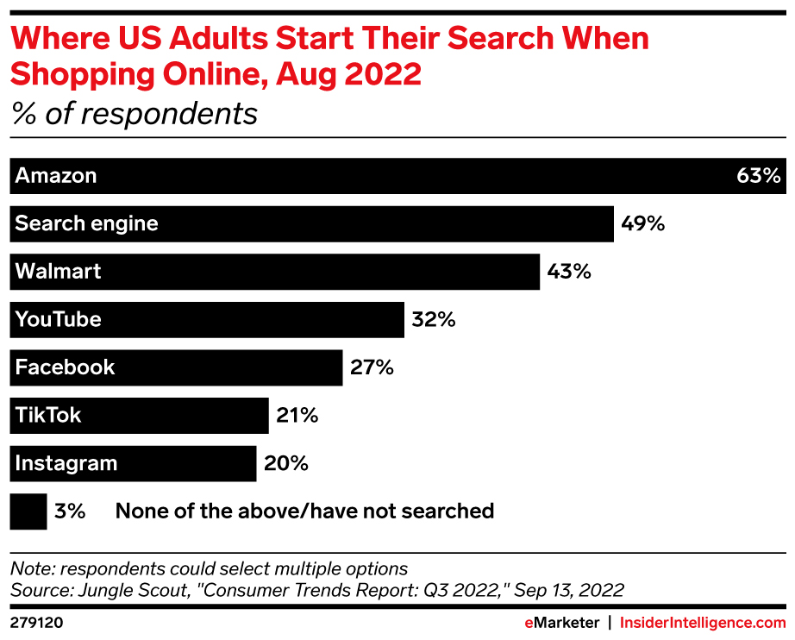
Profitability Requirements Puts Pressure on Brands’ Business Models
Sales strategies mixing direct-to-consumer with wholesale channels online and offline will prevail.
Increase (wholesale) distribution: Along with creating wider reach, increased distribution points spreads inventory liability.
Increase scope: Brands can no longer focus only on the core product or originally intended consumer.
Increase footprint: Brands continue to open or reimagine stores as physical retail drives sales and discover.
Notes:
Closed Loop measurement + First Party Targeting allays growing privacy concerns
Prices continue to rise as increased Ecommerce ad demand has grown (more retailers, brands)
Retail Media Ads are typically sold via auction & increase demand has triggered organic growth
Advertisers have reported lower ROI
Increase in Retail Ecommerce Sales Overall

