Slide 1
Digital Advertising Trends to Watch for 2023
December 2022
Evelyn Mitchell
Analyst

Slide 2
Digital advertising will face another turbulent year
Advertisers are reducing spending on some channels more than others as macroeconomic conditions continue to deteriorate.
Privacy enforcement is heating up, but advertisers aren’t prepared for new legislation.
Big changes in content moderation could result from US Supreme Court decisions.
Amazon’s competitors in the retail media space are beefing up their offerings.

Slide 3
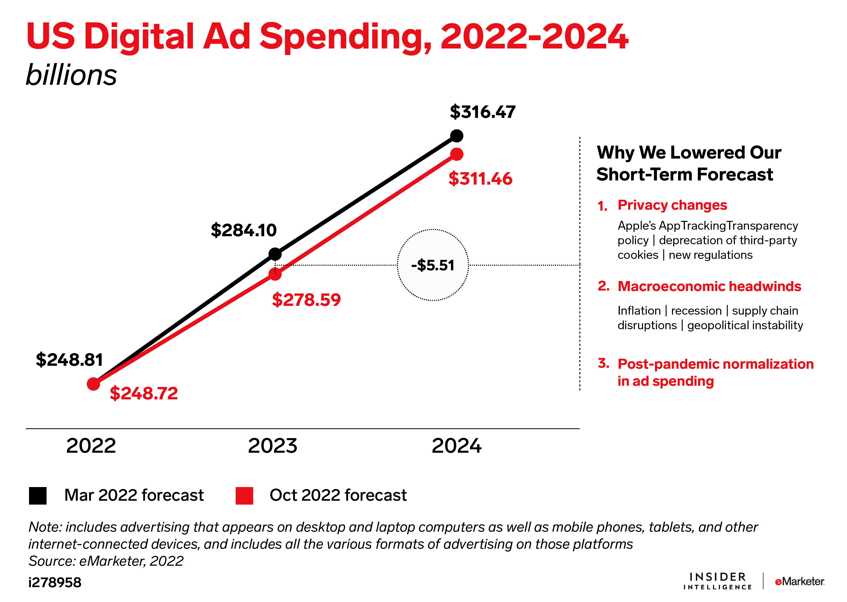
Trend No. 1: Digital ad spending downgraded amid economic instability
With inflation driving up operating costs and a potential recession looming, marketing is getting deprioritized. Our current outlook: Ad spending won’t bottom out.

Slide 4
Budget cuts will affect some channels more than others
Social networks will be hit the hardest as major platforms struggle to adapt to Apple’s privacy changes. We slashed our 2023 social network ad spending forecast:
Advertisers are still amping up spend on connected TV (CTV). Despite macroeconomic uncertainty and measurement challenges, we increased our CTV ad spending forecast:
-$16.21 billion
+$3.02 billion
to $71.05 billion. Meta accounts for most of that loss.
to $26.92 billion.

Slide 5
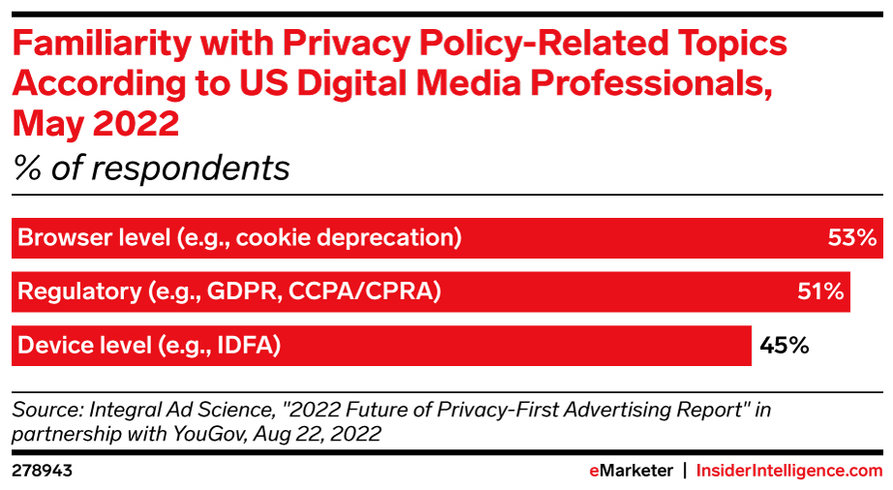
Trend No. 2: Advertisers aren’t prepared for privacy legislation
Advertisers are still talking about complying with the General Data Protection Regulation and the California Consumer Privacy Act, years after the laws went into effect.
In the US, a handful of state privacy laws will come into play in 2023, including the California Privacy Rights Act, which places additional restrictions on data sharing, an increasingly common method used by advertisers to address signal loss.

Slide 6
Trend No. 3: Big Tech will actually solve the content moderation problem … or else
Platforms might lose essential legal protection.
Any change to Section 230 would be a huge deal.
During its current term, which will wrap up by October 2023, the US Supreme Court will hear its first-ever cases involving Section 230 of the Communications Decency Act of 1996.
The law protects online platforms from being held liable for what their users post while still allowing the platforms to moderate objectionable content.
If platforms become liable for user-generated content, they would likely have to strengthen content moderation or risk being sued for defamation, incitement of violence, or illegal distribution of materials like pornography.

Slide 7
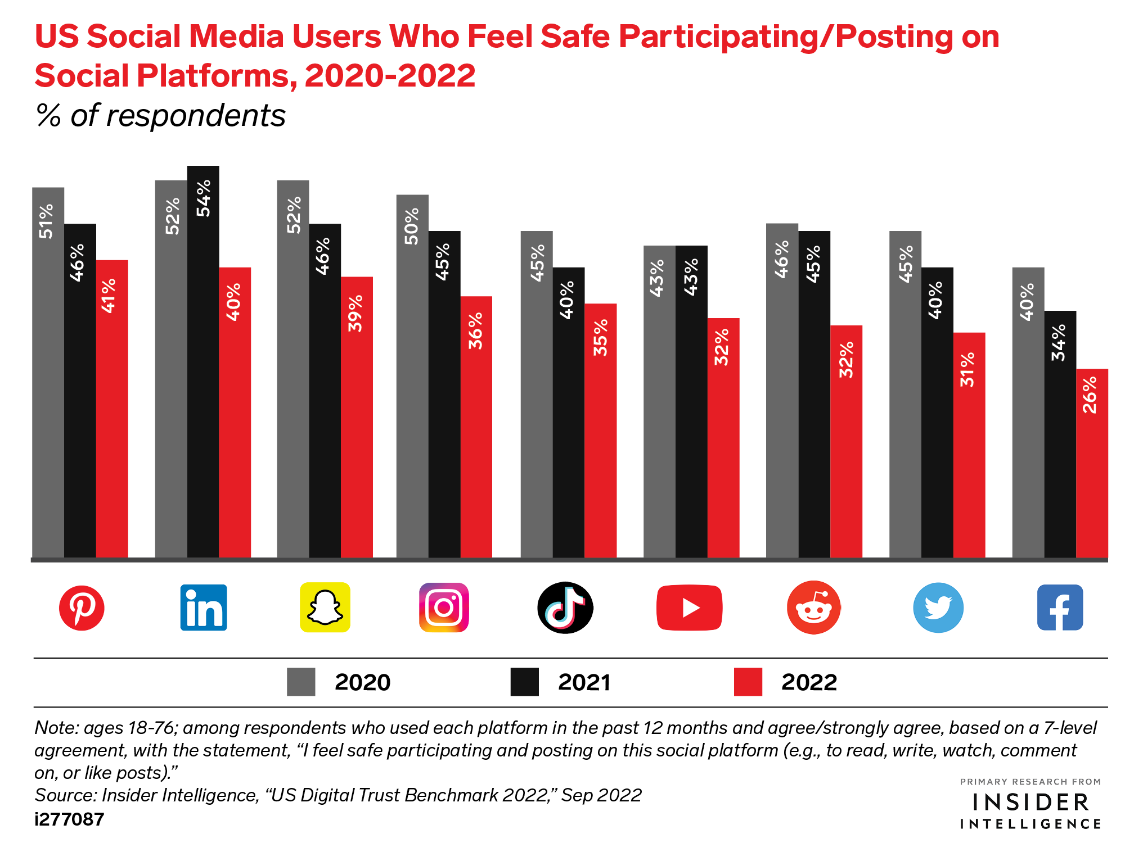
Less than half of social media users felt safe participating or posting on major social platforms as of September 2022.
More content moderation could help. But some might abandon social media if they feel too much content is taken down.

Slide 8
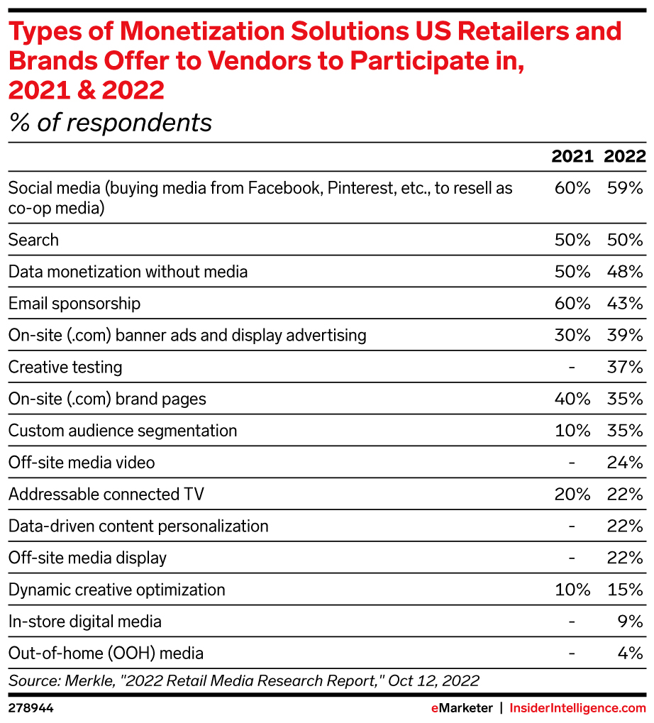
Trend No. 4: Retail media platforms will diversify to compete with Amazon
Off-site inventory will proliferate as retailers continue to ink deals with publishers and supply-side platforms (SSPs) that want in on the action.
Amazon competitors with larger brick-and-mortar footprints have a key advantage with in-store media, especially as consumers return to shopping in-person.
More retailers will provide custom audience segmentation, a solution that exploded in popularity over the past year, according to research from Merkle.

Slide 9
Our predictions for digital advertising
Programmatic channels will win as advertisers prioritize flexibility.
The era of “accept all cookies” buttons will end.
Expect programmatic ad spending to grow strongly across display, digital out-of-home, and podcasting next year.
Any business collecting first-party data will need to enhance their consent frameworks to avoid legal action in certain jurisdictions, like California.
Macroeconomic conditions will supercharge measurement innovation.
The Supreme Court won’t declare Section 230 unconstitutional.
Platforms will address their measurement issues. Advertisers that move on from pre-ATT expectations and do more with less data will succeed.
But it could alter the way the law is interpreted, spelling trouble for players like TikTok and Google that use algorithms to surface content to users.
2023 will come and go without a federal privacy law in the US.
Nonendemic advertisers will dabble in retail media.
Instead, the ad industry will deal with legislation state by state, on top of various international laws.
Non-CPG brands will start investing, even without the promise of closed-loop attribution.

